Slide 1

Inheritance, Polymorphism in C#
Mr. Krishnaraj

Slide 2

Todays Agenda
1
Inheritance
2
Types of Inheritance
3
Polymorphism
4
Use Cases
5
Assignments
6
Debrief

Slide 3

Inheritance
Inheritance is one of the foundational concepts of Object-Oriented Programming (OOP).
It allows a class to reuse the members (fields, properties, and methods) of another class.
Inheritance establishes a hierarchical relationship between two classes, enabling code reuse, extension, and organization.
The class that provides its members is called the base class (or parent class), and the class that inherits from it is called the derived class (or child class).
Basic Terminology
Base Class : The class that is inherited from.
Derived Class : The class that inherits from the base class.

Slide 4
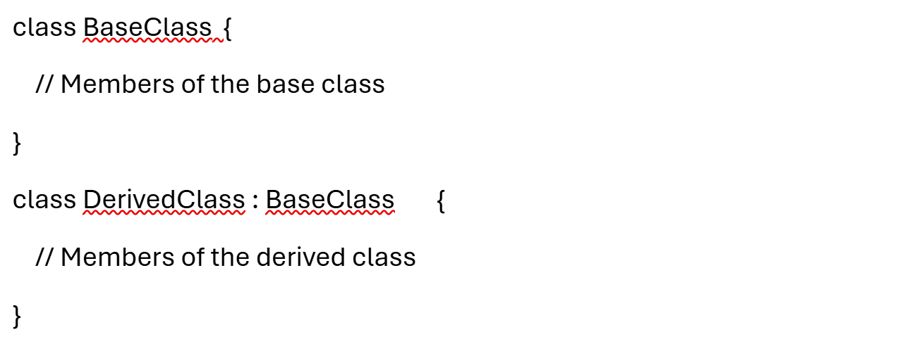
Inheritance
Syntax:

Slide 5
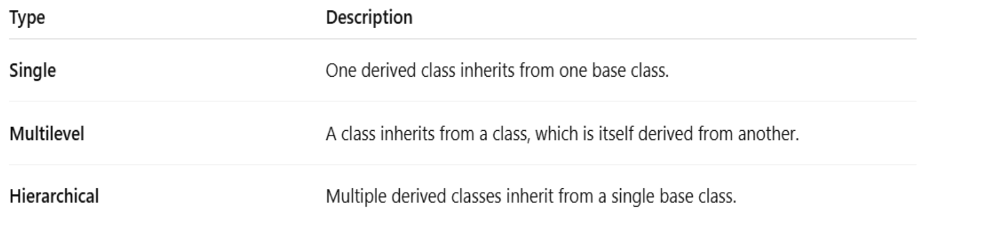
Inheritance
Types of Inheritance:

Slide 6
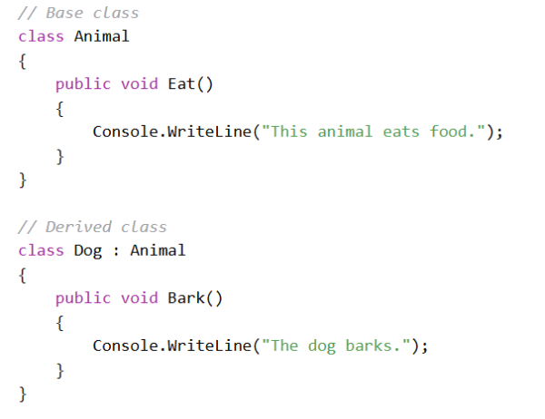
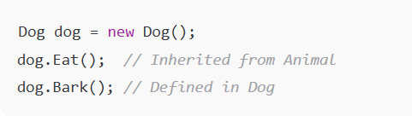
Inheritance
Single Inheritance:

Slide 7
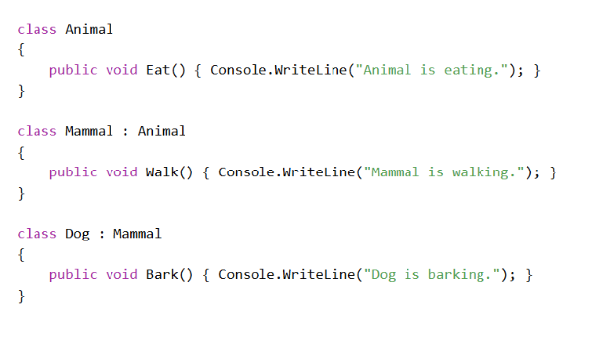
Inheritance
Multilevel Inheritance:

Slide 8
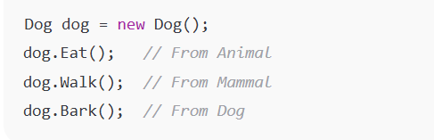
Inheritance
Multilevel Inheritance:

Slide 9
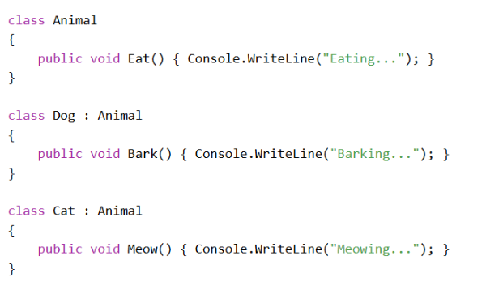
Inheritance
Hierarchical Inheritance:

Slide 10
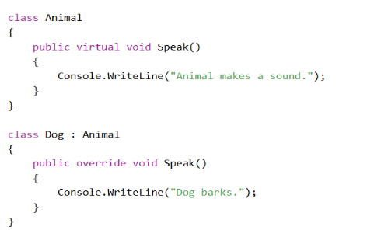
Inheritance
Method Overriding:
Derived class can modify the behavior of a method inherited from the base class. This is called method overriding. Example,

Slide 11
Polymorphism
Polymorphism allows the same operation to behave differently based on the context.
Types of Polymorphism:
Compile-Time Polymorphism: Also known as Method Overloading; decided at compile time.
Run-Time Polymorphism: Also known as Method Overriding; decided at runtime.
Method Overriding:
Allows a derived class to provide a specific implementation of a method that is already defined in its base class.
The base class method must be marked with the virtual keyword.
The derived class method must use the override keyword.

Slide 12
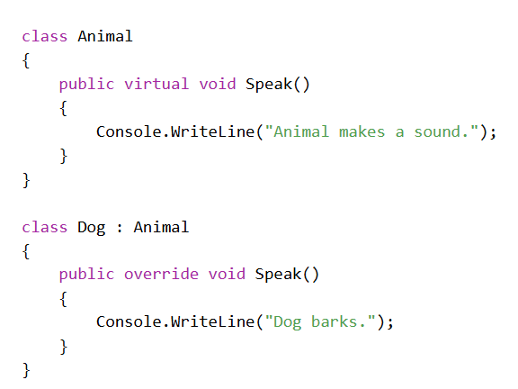
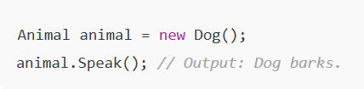
Polymorphism
Example:

Slide 13
Use Cases

Slide 14

Assignment
Sample Motivational Quotes:
"You're doing great!",
"Every step counts!",
"Keep pushing!",
"Believe in yourself!",
"Flutter on!"

Slide 15

+
+
+
+
LEVEL
Stretch Goals
+
UP
+
+

Slide 16
Debrief
Inheritance
Types of Inheritance
Polymorphism
Use cases

Slide 17
📘 Official Resources (High-Quality & Up-to-Date)
References

Slide 18

Thank you

